Slide 1
TM4C123GH6PM Architecture

Slide 2
Stellaris TM4C123 Microcontroller
microcontroller (TM4C123)
ICode Bus
System Bus
microprocessor
Input
Ports
PPB
Internal Peripherals & NVIC
Output
Ports
DCode Bus
Instructions
Flash ROM
Data
RAM

Slide 3
TM4C123 IO Architecture

Slide 4
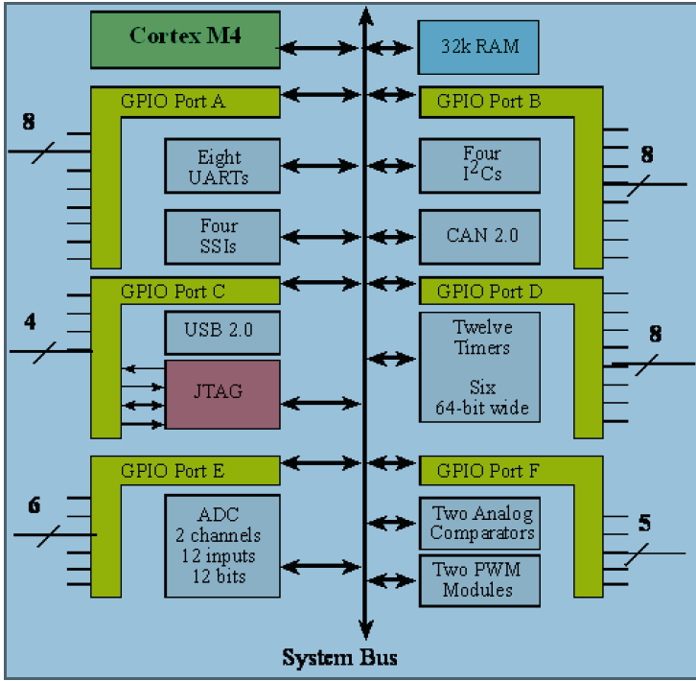
IO Architecture

Slide 5
IO Architecture
GPIO (General Purpose IO) – Switch/LED
A, B, D: 8 bits each
C: 4 bits, E: 6 bits, F: 5 bits
UART (Universal Asynchronous Receiver Transmitter)
UART0, UART1, UART2
PC –to– TM4C123
ADC Channels 0-7
Timer – used in this class for . . .
SysTick, Timer0, Timer1, Timer2, Timer3

Slide 6
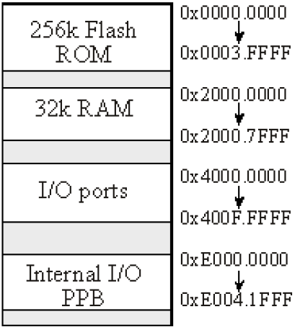
Memory Map

Slide 7
Size of ROM > Size of RAM

Slide 8
Size of ROM > Size of RAM
Embedded Systems do not use much RAM
E.g., do not download web-pages, do not write to files

Slide 9
Size of ROM > Size of RAM
Embedded Systems do not use much RAM
E.g., do not download web-pages, do not write to files
Constants in ROM

Slide 10
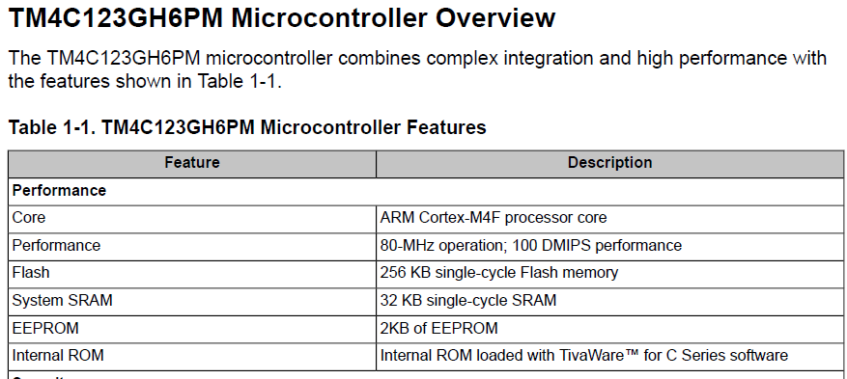
Memory details in Data Sheet
Page 46

Slide 11
Memory Mapped IO vs. Port Mapped IO
Memory-mapped I/O
same bus to address both memory and I/O
Same CPU instructions to access memory & IO
Port-mapped I/O
Special class of CPU instructions for I/O. e.g., Intel x86, IN and OUT instructions

Slide 12
GPIO
General Purpose Input Output
No special purpose
Very configurable – same pin can be in/out
each pin can sink/source different voltage values
Will be used heavily in this class
In: Switch
Output: LED

Slide 13
IO Basics

Slide 14
IO Basics
Switch
LED
Tristate Buffer

Slide 15
GPIO Input

Slide 16
GPIO (Input)
Microcontroller reads signals from external world
LDR Rx, =Pin_Address LDR Ry, [Rx]
Bus
Read from Port Address
Processor
Input

Slide 17
GPIO (Input)
Address Bit = 1
Tristate Driver enabled
Input is read
EN Input Proc_Reads
1 0 0
1 1 1
Bus
Read from Port Address
Processor
Input

Slide 18
GPIO (Input)
Address Bit = 0
Tristate Driver disabled
Input is not read
EN Input Proc_Reads
0 0 Hi-Z
0 1 Hi-Z
Bus
Read from Port Address
Processor
Input

Slide 19
GPIO Output

Slide 20
GPIO (Output)
Microcontroller writes signals to external world
LDR Rx, =Pin_Address STR Ry, [Rx]
Bus
D
Q
Processor
Output
Write to Port Address

Slide 21
GPIO (Output)
Microcontroller writes signals to external world
LDR Rx, =Pin_Address STR Ry, [Rx]
Bus
D
Q
Processor
Output
Write to Port Address

Slide 22
GPIO (Output)
Microcontroller writes signals to external world
Output is readable as well!
Bus
D
Q
Processor
Output
Write to Port Address

Slide 23
GPIO (Output)
Microcontroller writes signals to external world
Output is readable as well!
Bus
Read from Port Address
D
Q
Processor
Output
Write to Port Address

Slide 24
GPIO Input-Output
Ports are never input-only or output-only

Slide 25
GPIO (Input AND Output)
Port is initialized as either Input or Output
Port direction can be reconfigured at run time

Slide 26
GPIO (Input and Output)
How can we CONFIGURE a port be an input at some time and as an output at other times?
Bus
Bus
Read from Port Address
Read from Port Address
D
Q
Processor
Input
Processor
Output
Write to Port Address
Input Port
Readable Output Port

Slide 27
GPIO (Configuring Direction)
Bi-directional control
Bus
Read from Port Address
D
Q
Processor
Output
Write to Port Address
D
Q
Write to Port Direction Register

Slide 28
GPIO (Configuring Direction)
Output
Direction Register = 1
Bus
Read from Port Address
D
Q
Processor
Output
Write to Port Address
D
Q
Write to Port Direction Register

Slide 29
GPIO (Configuring Direction)
Output
Direction Register = 1
Bus
Read from Port Address
D
Q
Processor
Output
Write to Port Address
D
Q
Write to Port Direction Register

Slide 30
GPIO (Configuring Direction)
Output
Direction Register = 1
Bus
Read from Port Address
D
Q
Processor
Output
Write to Port Address
D
Q
Write to Port Direction Register

Slide 31
GPIO (Configuring Direction)
Output
Direction Register = 1
Bus
Read from Port Address
D
Q
Processor
Output
Write to Port Address
D
Q
Write to Port Direction Register

Slide 32
GPIO (Configuring Direction)
Input
Direction Register = 0
Bus
Read from Port Address
D
Q
Processor
Input
Write to Port Address
D
Q
Write to Port Direction Register

Slide 33
GPIO (Configuring Direction)
Input
Direction Register = 0
Bus
Read from Port Address
D
Q
Processor
Input
Write to Port Address
D
Q
Write to Port Direction Register

Slide 34
GPIO Initialization
Enable Clock
Wait for Clock to stabilize
Set Direction of data transfer (Input/Output)
Disable Alternate Function
Set PUR/PDR
Enable Port
Read/Write Data

Slide 35

?

Slide 36

?

Slide 37
Ceiling Fan – with Remote Control
Turn on Wall Switch
Wait . . .
Blow Air – Up or Down?
Fan or Light?
Press power on Remote
. . .
Enjoy

Slide 38
Ceiling Fan & GPIO

Slide 39
Ceiling Fan & GPIO
Turn on Wall Switch Enable CLK
Wait . . . Wait a sec
Blow Air – Up or Down? Direction IN/OUT
Fan or Light? Alternate Function
Press power on Remote Enable Data
. . . PUR/PDR
Enjoy Read/Write

Slide 40
GPIO
Clock Gate
Direction Register
Alternative Port Function
Enable
Data Access

Slide 41
GPIO Initialization
void PortF_Init(void){ volatile unsigned long delay;
SYSCTL_RCGC2_R |= 0x00000020; // 1) F clock
delay = SYSCTL_RCGC2_R; // delay
GPIO_PORTF_LOCK_R = 0x4C4F434B; // 2) unlock PortF PF0
GPIO_PORTF_CR_R = 0x1F; // allow changes to PF4-0
GPIO_PORTF_AMSEL_R = 0x00; // 3) disable analog function
GPIO_PORTF_PCTL_R = 0x00000000; // 4) GPIO clear bit PCTL
GPIO_PORTF_DIR_R = 0x0E; // 5) PF4,PF0 input, PF3,PF2,PF1 output
GPIO_PORTF_AFSEL_R = 0x00; // 6) no alternate function
GPIO_PORTF_PUR_R = 0x11; // enable pullup resistors on PF4,PF0
GPIO_PORTF_DEN_R = 0x1F; // 7) enable digital pins PF4-PF0
}

Slide 42
Bit Manipulations
SW1 = GPIO_PORTF_DATA_R&0x10;
// read PF4 into SW1
SW2 = GPIO_PORTF_DATA_R&0x01;
// read PF0 into SW2

Slide 43
Enable Clock

Slide 44
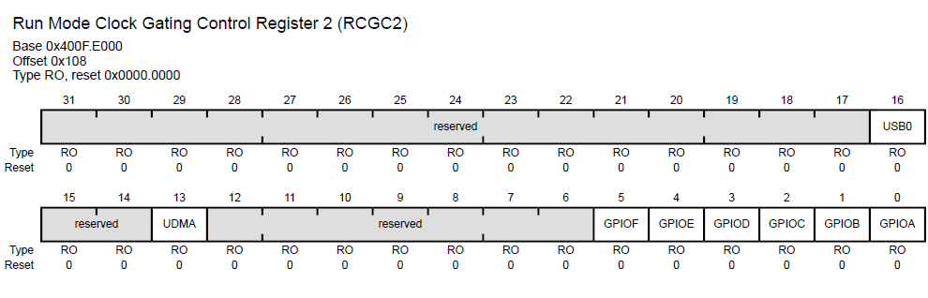
RCGC2 register
GPIO Run Mode Clock Gating Control
Used to control the clocking of the GPIO modules
#define SYSCTL_RCGC2_R (*((volatile unsigned long *)0x400FE108))
SYSCTL_RCGC2_R |= 0x00000020; // 1) F clock

Slide 45
GPIO_PORT_A
GPIO_PORT_B
SYSCTL_RCGC2_R
GPIO_PORT_C
GPIO_PORT_D
F
E
D
C
B
A
0
. . .
0
0
1
0
0
0
0
0
GPIO_PORT_E
GPIO_PORT_F

Slide 46
Enable Clock for GPIO_PORT_A

Slide 47
GPIO_PORT_A
GPIO_PORT_B
SYSCTL_RCGC2_R
GPIO_PORT_C
GPIO_PORT_D
F
E
D
C
B
A
0
. . .
0
0
0
0
0
0
0
1
GPIO_PORT_E
GPIO_PORT_F

Slide 48
Enable Clock for GPIO_PORT_D GPIO_PORT_F

Slide 49
GPIO_PORT_A
GPIO_PORT_B
SYSCTL_RCGC2_R
GPIO_PORT_C
GPIO_PORT_D
H
G
F
E
D
C
B
A
0
. . .
0
0
1
0
1
0
0
0
GPIO_PORT_E
GPIO_PORT_F
GPIO_PORT_H
GPIO_PORT_G

Slide 50
GPIO Initialization (Enable Clock)
SYSCTL_RCGC2_R EQU 0x400FE108
Port bit #n SYSCTL_RCGC2_R value
A 0 #0x00000001
B 1 #0x00000002
C 2 #0x00000004
D 3 #0x00000008
E 4 #0x00000010
F 5 #0x00000020
A&B 0&1 #0x00000003
D&F 3&5 #0x00000028
A&F 0&5 #0x00000021

Slide 51
Enable Clock for GPIO_PORT_A

Slide 52
GPIO Initialization (Enable Clock)
SYSCTL_RCGC2_R EQU 0x400FE108

Slide 53
GPIO Initialization (Enable Clock)
SYSCTL_RCGC2_R EQU 0x400FE108
LDR R1, =SYSCTL_RCGC2_R
LDR R0, [R1]
ORR R0, #0x00000001
STR R0, [R1]
SYSCTL_RCGC2_R |= 0x00000001;
// A clock

Slide 54
Enable Clock for GPIO_PORT_D GPIO_PORT_F

Slide 55
GPIO Initialization (Enable Clock)
SYSCTL_RCGC2_R EQU 0x400FE108
LDR R1, =SYSCTL_RCGC2_R
LDR R0, [R1]
ORR R0, #0x00000028
STR R0, [R1]
SYSCTL_RCGC2_R |= 0x00000028;
// D and F clock

Slide 57
Thank you!

